Slide 1


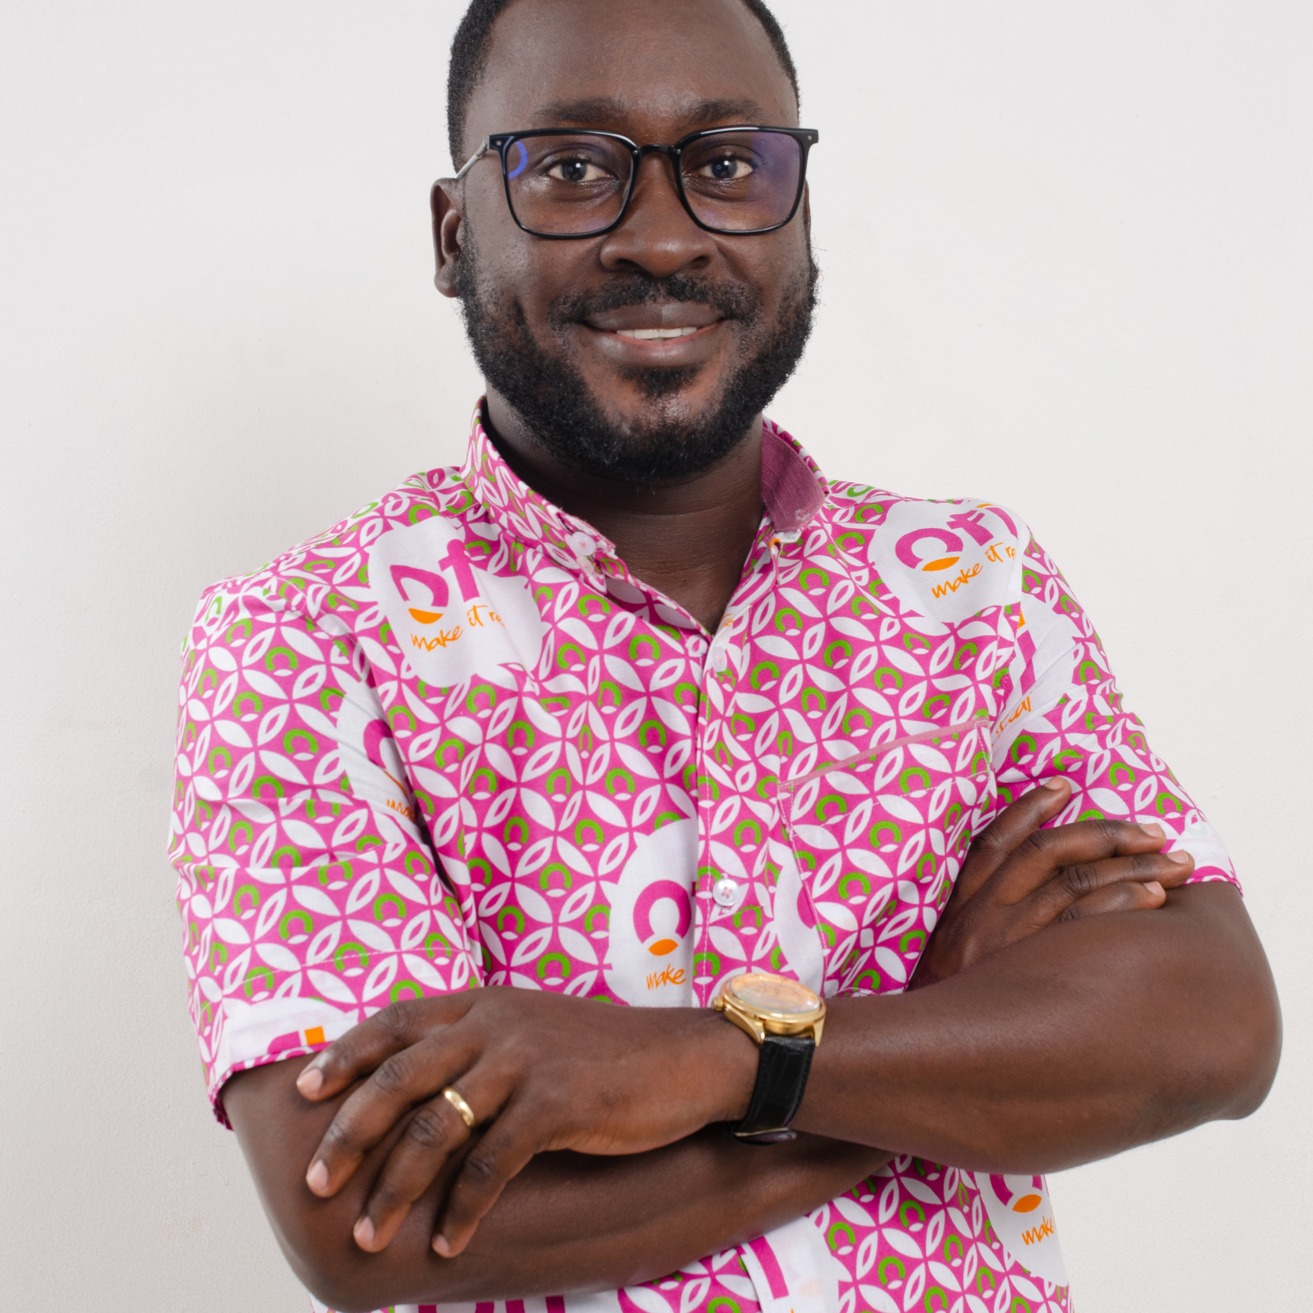
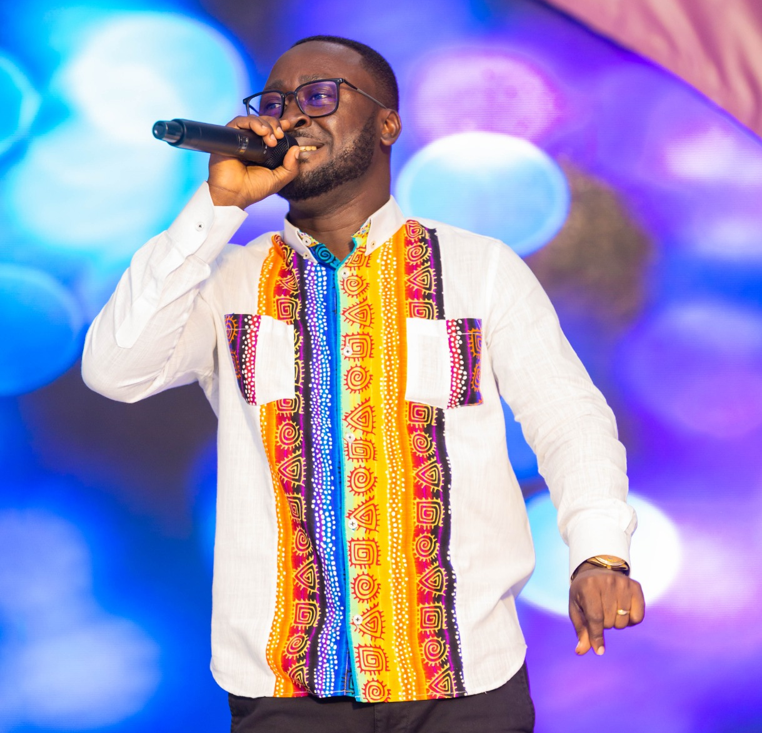
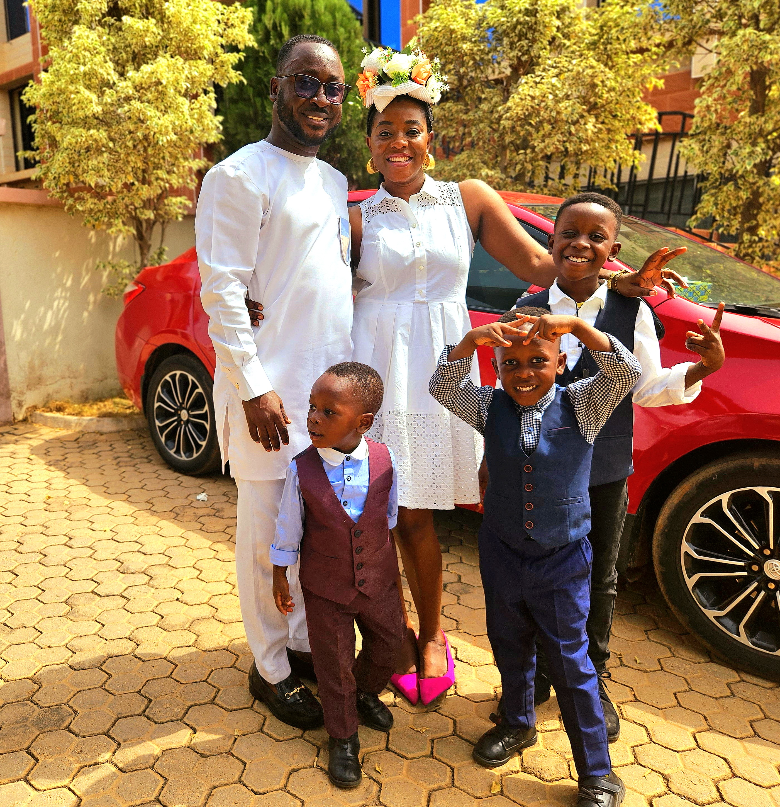
Getting to Know Me
Work
Personal
My role
Financial Accountant
Significant others / family members / furry friends in my life
I am married with three kids
Tenure in ofi/Olam
13 Years
How I enjoy spending my free time
Rehearsing and performing on stage with my band and spending good time with my family
Previous companies I have worked at
AngloGold Ashanti Limited
My favorite / comfort food
Fufu with Goat light soup
Why I joined ofi/Olam and what keeps me here?
My dream was to join a multinational that would give me the opportunity to grow my career and leadership skills. I always come across new challenges that do not look like threats but opportunities to grow myself in career and personal life, and that keeps me here.
My favorite song
“People Like You” by Gramps Morgan
Nana Darko Akonnor
Nana
A few fun facts about me
I always dance whenever I am stressed out to cool off. This has worked for me in most cases
This is me outside work, doing stuff I enjoy in my life …

